Slide 1

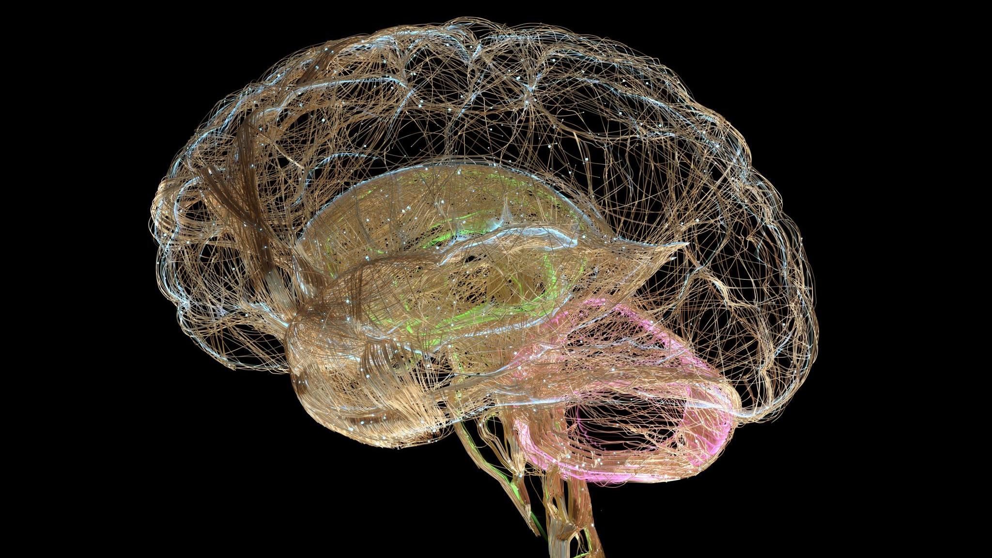
Brain Tumor Classification using CNN
By: Harshitha Mallappa

Slide 2

CRISP – DM Framework
Business Understanding
Data Understanding
Data Preparation & EDA
Modelling (Baseline vs Improved)
Evaluation & Business Impact
Summary, Recommendations & What-If
Q&A

Slide 3
Business Understanding: AI-Assisted Brain Tumor Detection from MRI Scans
Who is the customer?
Hospitals & diagnostic centers
Radiologists & medical imaging teams
Healthcare administrators
Why this problem matters:
Brain tumors are life-critical and require fast detection
Radiologists review hundreds of MRI scans daily → risk of delays and fatigue
Manual review is time-consuming and costly

Slide 4
Decision my analysis supports:
Should this MRI scan be flagged as high-priority for radiologist review?
Does the MRI show signs of a tumor or can it be categorized as low-risk?
Business objective & success metric:
Goal: Reduce radiologist review time per scan by 20% using AI-assisted screening
Success metric: ≥ 75% validation accuracy on tumor vs no-tumor classification

Slide 5
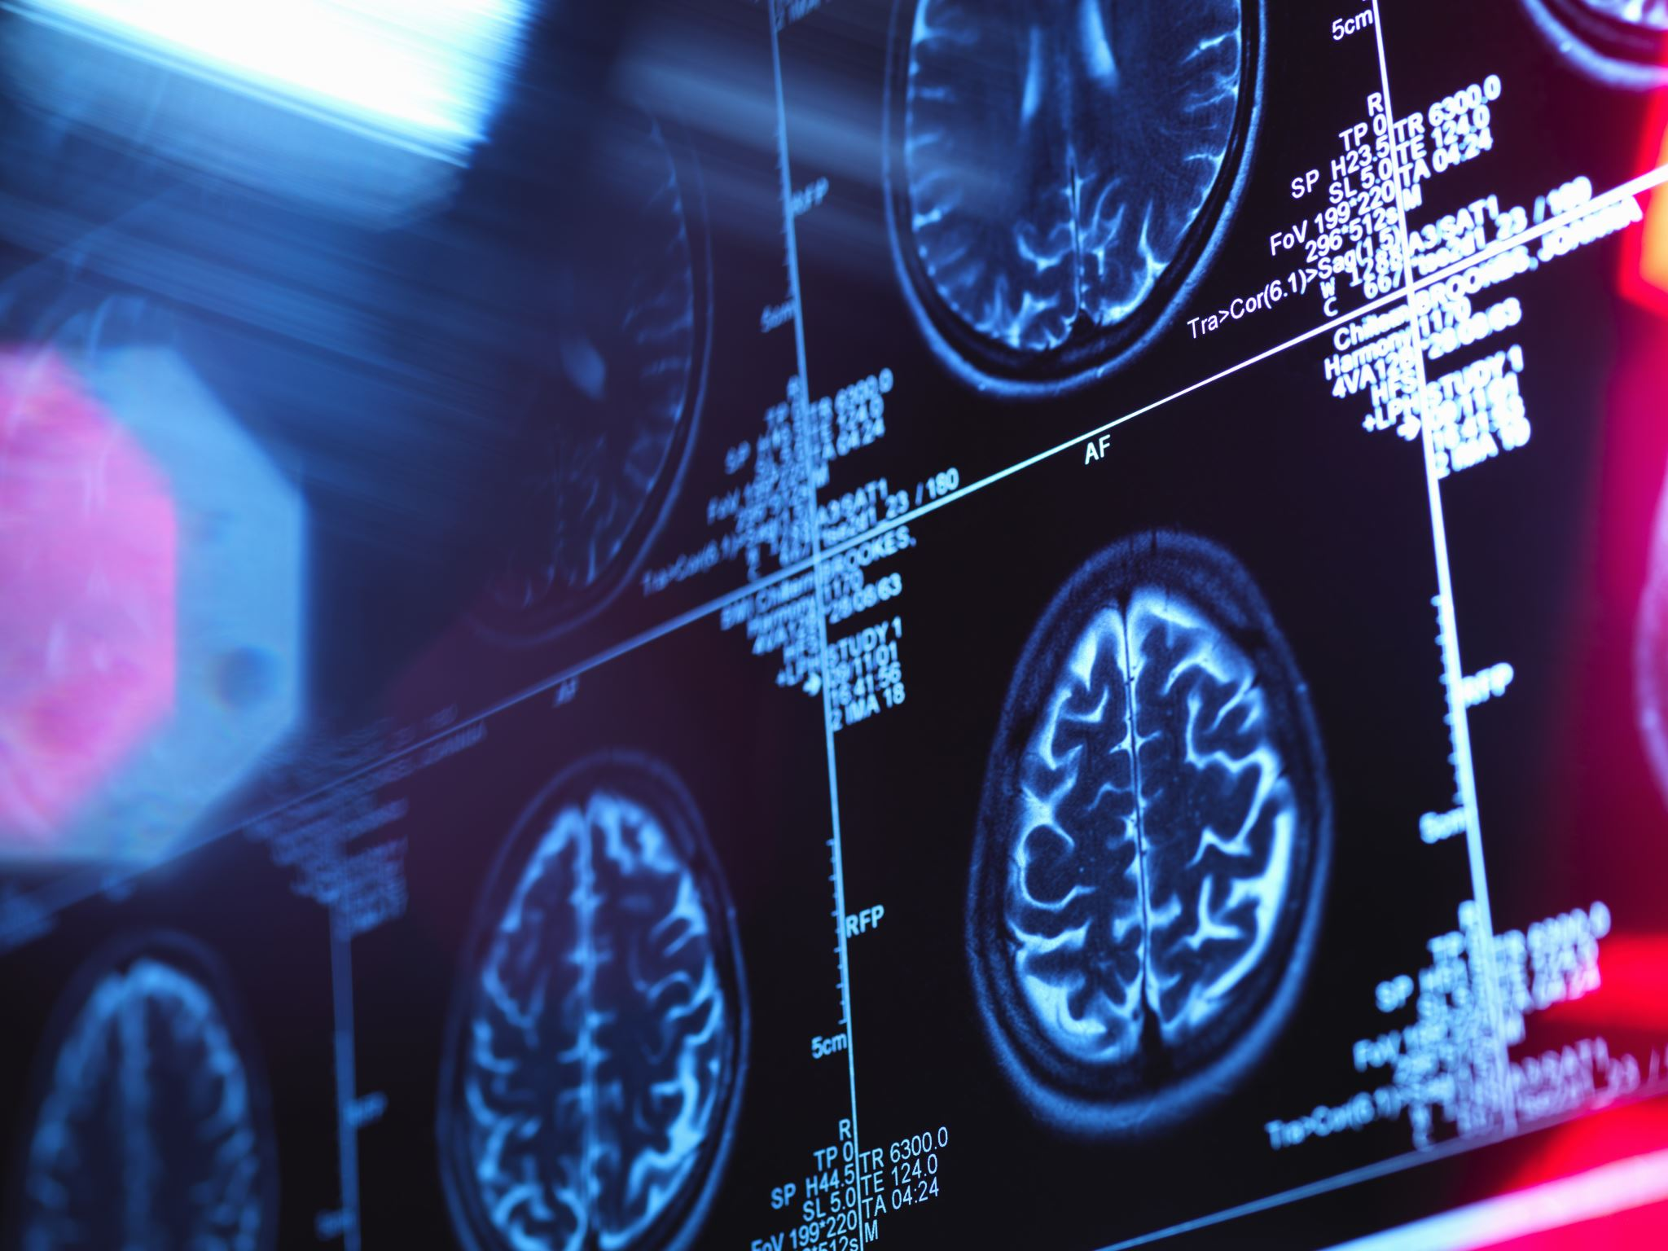

Dataset: Brain MRI Tumor Images (Kaggle)
Source & structure:
Open-source dataset from Kaggle
Two folders: yes/ (tumor) and no/ (no tumor)
Total images: 253
  155 tumor (yes)
  98 no tumor (no)
Why this dataset is suitable:
Directly matches the business problem: tumor vs no-tumor classification
Real MRI scans → closer to real-world hospital workflows
Clean folder structure → ideal for supervised CNN training

Slide 6
Limitations:
Limited dataset size → risk of overfitting
No metadata (age, gender, tumor type, MRI machine)
Binary labels only → cannot differentiate tumor types
Slight class imbalance (more tumor images)
Quick descriptive overview:
Class distribution is moderately balanced
Image sizes and brightness vary a lot → motivates resizing and normalization

Slide 7
Data Cleaning & Exploratory Analysis
Before vs After Cleaning:
Original MRI images → different sizes, resolutions, and brightness
All images resized to 150×150 pixels
Pixel values normalized to 0–1
Dataset split: 80% training / 20% validation
Prefetching used to speed up training
Key EDA Insights (Customer Insights for Hospital):
Image size variation
  Images range from ~150 to ~1900 pixels in width
  Confirms the need to standardize size to 150×150 for stable CNN performance

Slide 8
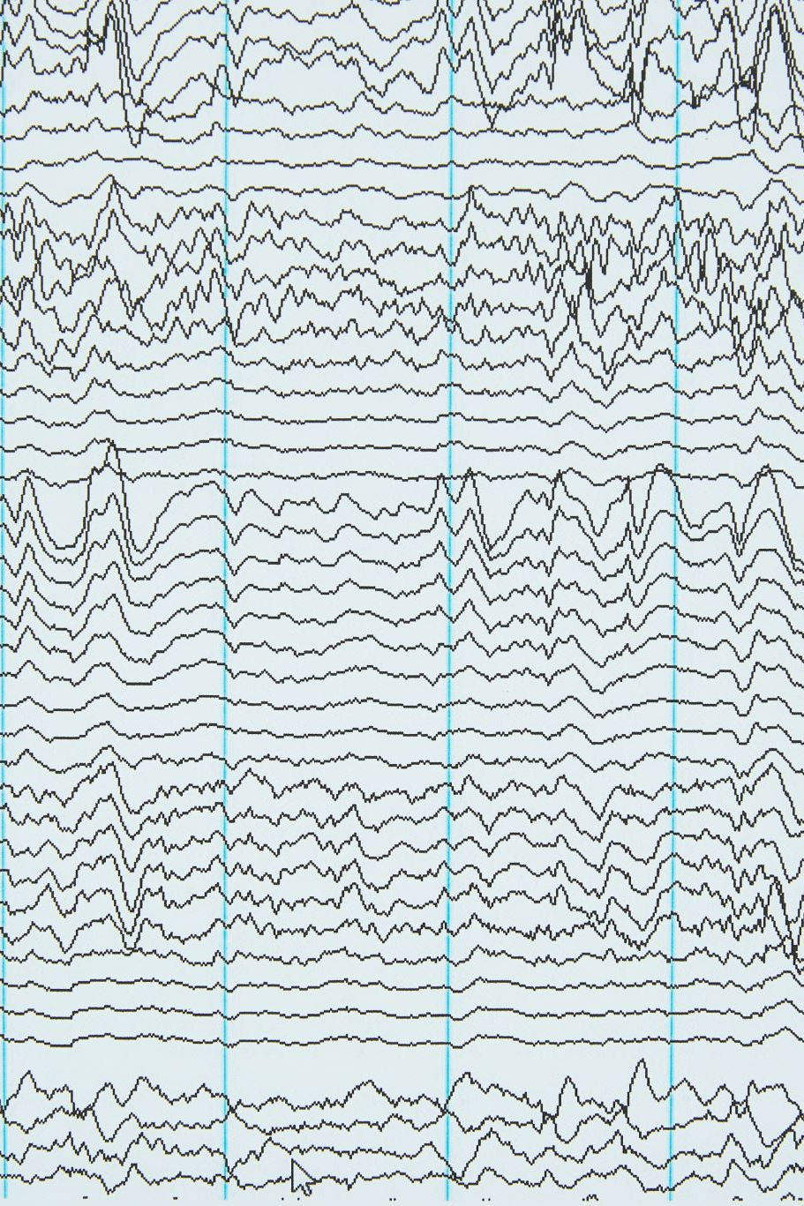
Brightness variation
  Mean pixel brightness varies widely across scans
  Justifies normalization (Rescaling(1/255)) to reduce lighting bias
Reasonable class balance
  Slightly more tumor images than non-tumor, but no extreme skew
  Good foundation for binary classification
Descriptive statistics support these decisions:
Total images, min/max/mean width
Min/max/mean brightness values

Slide 9
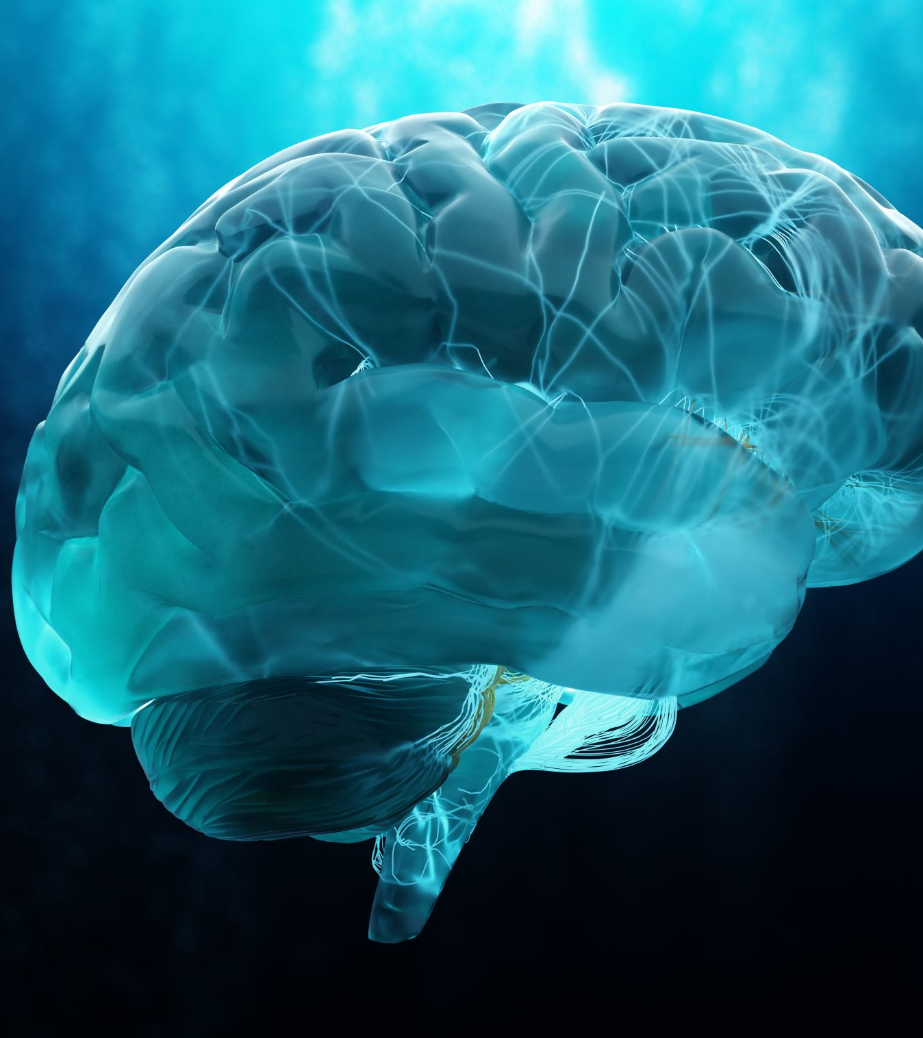
Modelling Approach (Baseline & Improved)
Business Modelling Task
Problem type: Binary classification
Input: MRI brain images
Output: Tumor / No Tumor
Baseline Model:
Simple CNN built using Conv2D + MaxPooling2D
Includes:
  Rescaling(1/255)
  3 convolution blocks
  Dense layer + sigmoid output
Purpose: establish a reference performance

Slide 10
Improved Model:
Adds Data Augmentation:
  RandomFlip, RandomRotation, RandomZoom
  Simulates variations in real MRI scans
Adds Dropout layers (0.3 and 0.5):
  Reduces overfitting by randomly dropping neurons
Uses a lower learning rate (1e-4) for smoother convergence
Why these methods?
CNNs are state-of-the-art for medical images
Augmentation + Dropout → better generalization to new patients
Aligns with the goal of safe, real-world clinical use

Slide 11
Model Evaluation & Clinical Impact
Key Technical Metrics (Improved CNN):
Validation Accuracy: 76%
Precision (Tumor): 78%
Recall (Tumor): 88%
F1-Score (Tumor): 83%
Interpretation for Business & Clinical Use:
High recall → the model detects most tumor cases
This is critical because missing a tumor is high risk
Precision of 78% means most flagged tumor cases are correct
Confusion matrix shows the model is better at detecting tumors than missing them, which is safer in medical settings

Slide 12

Business Impact Example:
AI model can handle first-pass screening of MRI scans
Radiologists focus first on scans marked high-risk
Even a modest reduction in per-scan review time can:
  Reduce diagnostic delays
  Improve patient throughput
  Lower clinician workload and fatigue

Slide 13

Summary, Recommendations & Next Steps
Key Findings (Plain Business Language):
Built an AI model that classifies MRI scans as Tumor vs No Tumor
Followed full CRISP-DM cycle: business understanding → EDA → modelling → evaluation
Improved CNN model achieved solid performance with 88% tumor recall
Model is most useful as a clinical triage assistant
Recommendations for Hospital / Business Stakeholders:
Use the model as a decision-support tool, not a replacement for radiologists
Prioritize MRI scans flagged as high-risk by the model
Retrain periodically with new MRI data to maintain performance
Monitor real-world performance and adjust thresholds if required
Adopt a “human-in-the-loop” workflow → AI + radiologist together

Slide 14

What-If & Future Work:
With more data, expand to multiclass tumor types
Add tumor segmentation, not just classification
Use more advanced pretrained models (ResNet, EfficientNet)
Integrate Grad-CAM heatmaps for explainable AI
Extend from 2D scans to 3D MRI volumes

Slide 15

Thank You
Q&A?

